Slide 1
Social Selling, Quick Commerce and FMCG
What do we know from studies?
Team Number 10

Slide 2
Key Questions
Which generation contributes to the most online sales today?
How can the companies attract younger generation? Why is it important to create value and a sense of belonging for the younger consumers?
How can social media platforms allow to create more engagement for FMCG sales?
In what ways can companies take advantage of various social media platforms to increase sales?
Why is it important for companies to stand for current social issues and support sustainability initiatives?

Slide 3
Studies Consulted
Shiqian, Y., & Benfratello, P. L. (2021, March). Economic Analysis of the FMCG Industry In China (Fast Moving Consumer Goods). Politecnico Di Torino.
https://webthesis.biblio.polito.it/17759/1/tesi.pdf
Dave Evans. (2008). Social Media Marketing : An Hour a Day. Sybex.
Francis, T., & Hoefel, F. (2020, December 16). ‘True Gen’: Generation Z and its implications for companies. McKinsey & Company.
https://www.mckinsey.com/industries/consumer-packaged-goods/our-insights/true-gen-generation-z-and-its-implications-for-companies
Bu, Y., Parkinson, J., & Thaichon, P. (2022). Influencer marketing: Homophily, customer value co-creation behaviour and purchase intention (Volume 66). Elsevier Ltd. https://doi.org/10.1016/j.jretconser.2021.102904
Deloitte. (2021, September). Resilience in the FMCG & Retail Sector. https://www2.deloitte.com/content/dam/Deloitte/in/Documents/consumer-business/in-cb-resilience-in-the-FMCG-retail-sectors-noexp.pdf

Slide 4
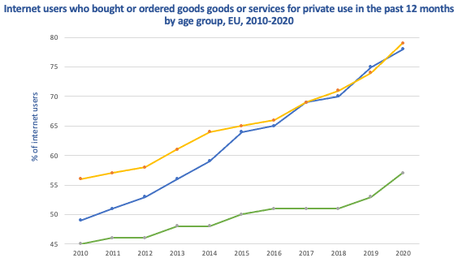
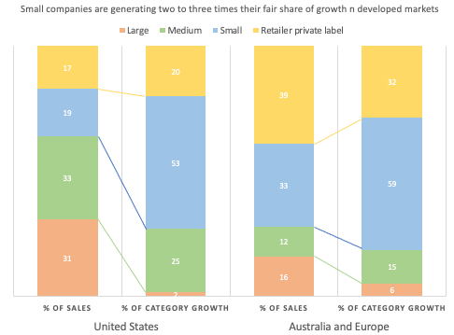
Different preferential choices between generations
Based on recent McKinsey research Gen Z and Millennials are almost four times more likely than baby boomers to avoid buying products from “the big companies.” (Kelly et al., 2019)
Based on research millennials like to study and research about the products they want to buy and listen to reviews from close ones. They prefer small and new businesses as they are more modern and innovative and they avoid shopping from big brands and dismiss their related marketing. (Shiqian & Benfratello, 2021)
Younger generation are more open to sharing their data online, allowing various brands to direct them with more personalized suggestions and advertisements.
References: Shiqian, Y., & Benfratello, P. L. (2021, March). Economic Analysis of the FMCG Industry In China (Fast Moving Consumer Goods). Politecnico Di Torino. https://webthesis.biblio.polito.it/17759/1/tesi.pdf
Kelly, G., Kopka, U., Küpper, J., & Moulton, J. (2019, January 11). The new model for consumer goods. McKinsey & Company. https://www.mckinsey.com/industries/consumer-packaged-goods/our-insights/the-new-model-for-consumer-goods

Slide 5
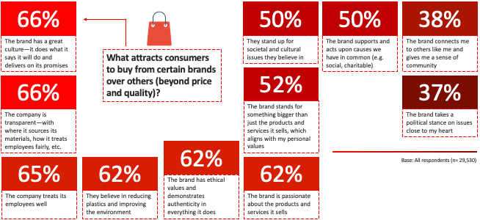
Companies should stand for current issues and initiate sustainable strategies
Based on 14th annual Global Consumer Pulse Research conducted on 29,530 customers, it was found that 62% of the consumers want organizations to stand and take actions on current issues like sustainability, maintaining transparency or equality. (Accenture Strategy, n.d.)
Based on studies, approximately 60% of Millennials and Gen Z and more than 50% of Boomers and Gen X consider it’s necessary for organizations to stand for and take actions on issues like sustainability, LGBTQ and human rights. This indicates that brand purpose will be most crucial for upcoming generations. (Accenture Strategy, n.d.)
Consumers awareness on products and its impact on the environment has enhanced over the recent years. They prefer spending more and making responsible choices by switching to sustainable products.
References: Accenture Strategy. (n.d.). TO AFFINITY AND BEYOND FROM ME TO WE, THE RISE OF THE PURPOSE-LED BRAND. Accenture. https://www.accenture.com/_acnmedia/thought-leadership-assets/pdf/accenture-competitiveagility-gcpr-pov.pdf

Slide 6
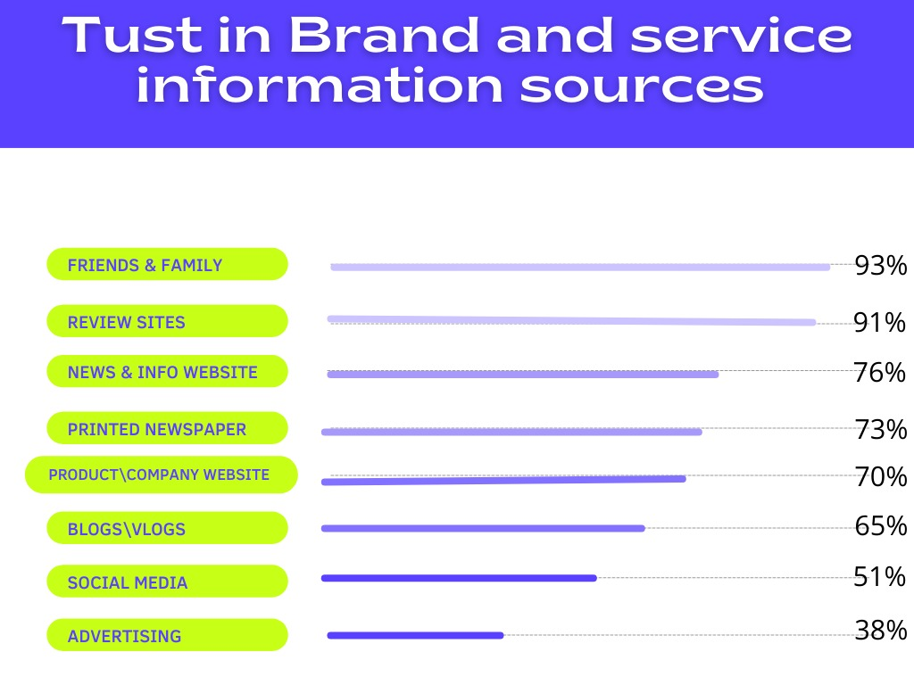
Social Media Platforms have become go-to catalogues and review hub for consumers
Based on research it is shown that 91% of Millennials and Gen Z trust online reviews more, from which 93% of consumers say this impacted their buying choices. Nearly 97% of the consumers use social media platforms to research products before buying. (Kaemingk, 2022)
New e-commerce features on Instagram, TikTok, Youtube and other platforms are now seen by consumers as real-time catalogues where they can see products in action, along with reviews from influencers and other peers. Based on studies it is shown that people trust other consumers seven times more than brand advertisements.
Developing a strong social media presence and advertisements by involving consumers while marketing will help consumer brands create stronger, more loyal relationships with their audiences and thus resulting in increase of sales.
References: Kaemingk, D. (2022, January 13). Online reviews statistics to know in 2022. Qualtrics. https://www.qualtrics.com/blog/online-review-stats/

Slide 7
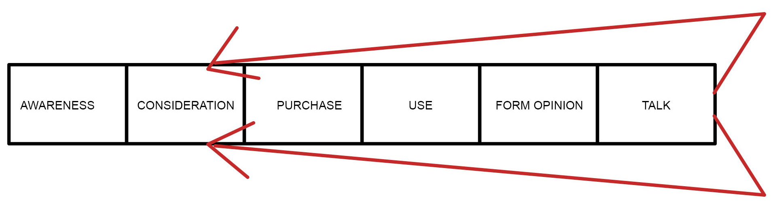
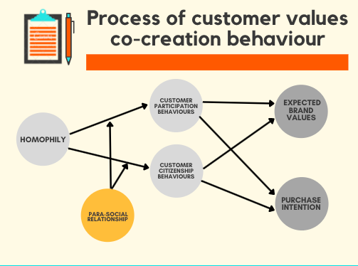
Companies need to expand their strategies beyond purchase
Companies that include consumers in the post purchase experience of the marketing process notice more trust, customer loyalty and sales when compared to companies who follow traditional business models
Consumers play a huge role in a success of a brand, therefore it’s important to reevaluate the engagement models. Organizations should concentrate less on spending for the consumers instead they should invest more in these new partnerships with customers to increase competitive advantage.
Having consumers act as sales associate through social media to influence by giving reviews or recommendations, allowing them to participate in providing constant feedback to improve on or giving ideas to bring in new products or innovation in exchange for some rewards. These will help companies connect with consumers on a deeper level by creating a community with loyal and committed partners to lead the way to a new age of collaboration and competitiveness.

Slide 8
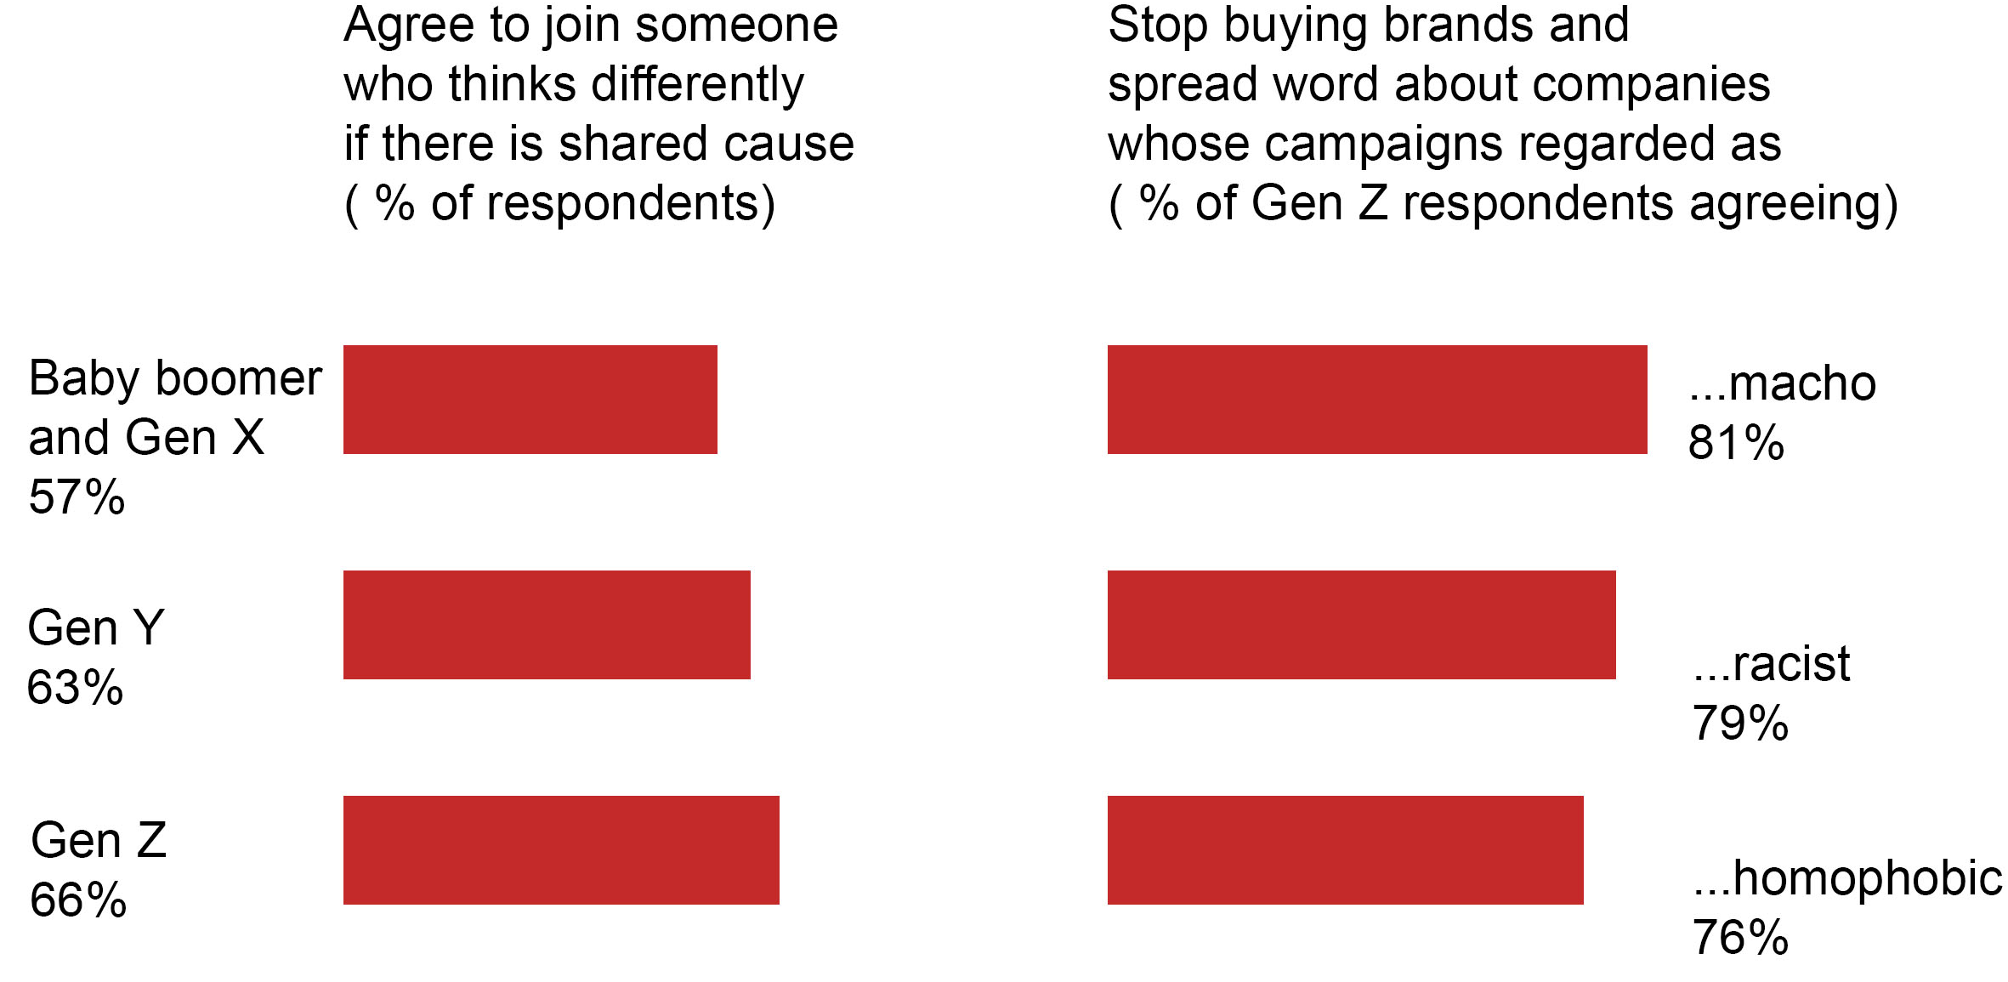
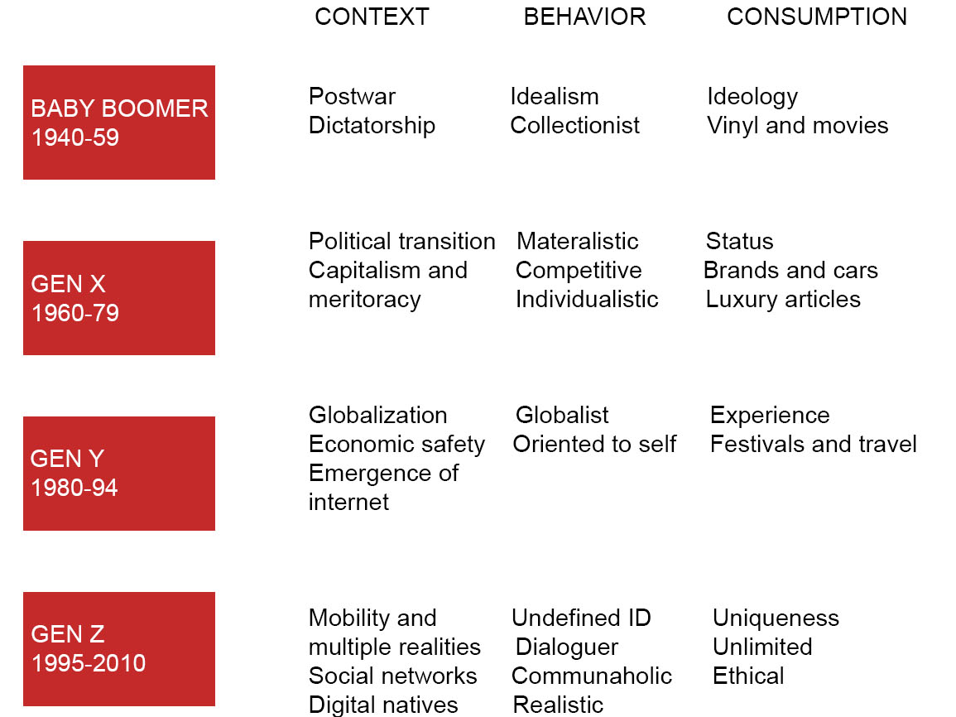
Not Me, Not the Company but ‘WE’ attitude
Companies should create value or sense of belonging for younger generation
According to the research, new generation which is in the workforce and are starting families, want to feel 'included' in the process of developing and choosing products.
There are now five live generations on the planet. All generations have different expectations in life—Baby Boomers demand quality from items, Gen Y expects meaning and emotion, and Gen A seeks meaning and feeling. Consumer-generated content mirrors generational norms, and as millennials enter the marketing power band, their online actions grow more crucial. There is a more manageable method for telling their stories in various ways. Others can contribute their ideas, creating a 'us' experience. Millennials have so much influence in the marketing world. Their attitude is "we" vs. the boomer mindset of "me,"' and this is more visible in wikis, which are mashups of current software services to create something like Google Maps (Daves,2008). All of them encourage involvement and are governed mainly by the collective. Young people have long personified their countries' zeitgeist, powerfully affecting trends and behavior.
The impact of Gen Z—the first generation of real digital natives—is already spreading, with the pursuit of truth at the heart of its characteristic behavior and consumption habits. Young people now have unprecedented levels of connectedness among themselves and the rest of the population because of technological advancements (Francis & Hoefel, 2018). This is why they are more likely to influence each other than company campaigns.
References: Dave Evans. (2008). Social Media Marketing : An Hour a Day. Sybex.
Francis, T., & Hoefel, F. (2020, December 16). ‘True Gen’: Generation Z and its implications for companies. McKinsey & Company.
https://www.mckinsey.com/industries/consumer-packaged-goods/our-insights/true-gen-generation-z-and-its-implications-for-companies

Slide 9
Recommendations
Collaborating with new sustainable, eco- friendly and creative brands to attract younger generations
Build marketing strategies to collaborate with customers to post reviews and engage on social media through hashtags or hold competitions in exchange of small perks
Involving customers beyond purchasing by asking for constant feedback and improving thus connecting with them on a deeper level to form a community.
Take positive actions towards various current issues such as sustainability, human rights, LGBTQ to build brand trust and to create a lasting bond with the consumers.
Encourage participations and maintain transparency with customers to make them feel more ‘involved’ in the process

